Slide 1
DDS For Live Session
UNIT 1

Slide 2
For Live Session: Unit 1 Due 24 hours before live session.
For each number, provide at least 1 Powerpoint slide to provide a clear presentation of your response. You will present most of these slides in a break out and are given a score based on their completeness and clarity. Most importantly, they will maximize your live session experience!
Data Science Profile: Make a bar plot for your data science profile.
CLT: Using the central limit code from the asynch material (CLT2.Rmd), adapt the code and provide the following analysis:
Adapt the code to generate a population of 10,000,000 from a chi-square distribution with 2 degrees of freedom. This is a heavily right skewed distribution. (Hint: rchisq()). You will have to read up on this function and probably do some trial and error. Being able to earn new functions and methods is a key skill.
Provide a histogram of this population… display the right skewness.
Record the mean and standard deviation of this population.
According to the central limit theorem, what should be the approximate distribution of sample means of size 50 from this right skewed population? What should be the mean and standard error of the mean (standard deviation of the distribution of sample means)?
Now let’s check this: Adapt the CLT code to draw 10,000 means each of size 50 from this population and provide the sampling distribution of this sample mean. Provide a histogram of these 10,000 sample means.
What is the mean and standard deviation of these 10,000 sample means?
T-Test
Research in R how to conduct a T-test (t.test) and conduct a six step hypothesis test to answer the question on the next slide. If you would like to brush up on hypothesis tests, please see the Bridge Course for Statistics.
Takeaways and/or Questions: What were your key – takeaways from from this unit and what were any question or comments you would like to make? Your professor will use these to customize live session.

Slide 3

1 Hypothesis Test
The following are ages of 7 randomly chosen patrons seen leaving the Beach Comber in South Mission Beach at 7pm! We assume that the data come from a normal distribution and would like to test the claim that the mean age of the distribution of Comber patrons is different than 21. Conduct a 6 step hypothesis test to test this claim.
25, 19, 37, 29, 40, 28, 31

Slide 4
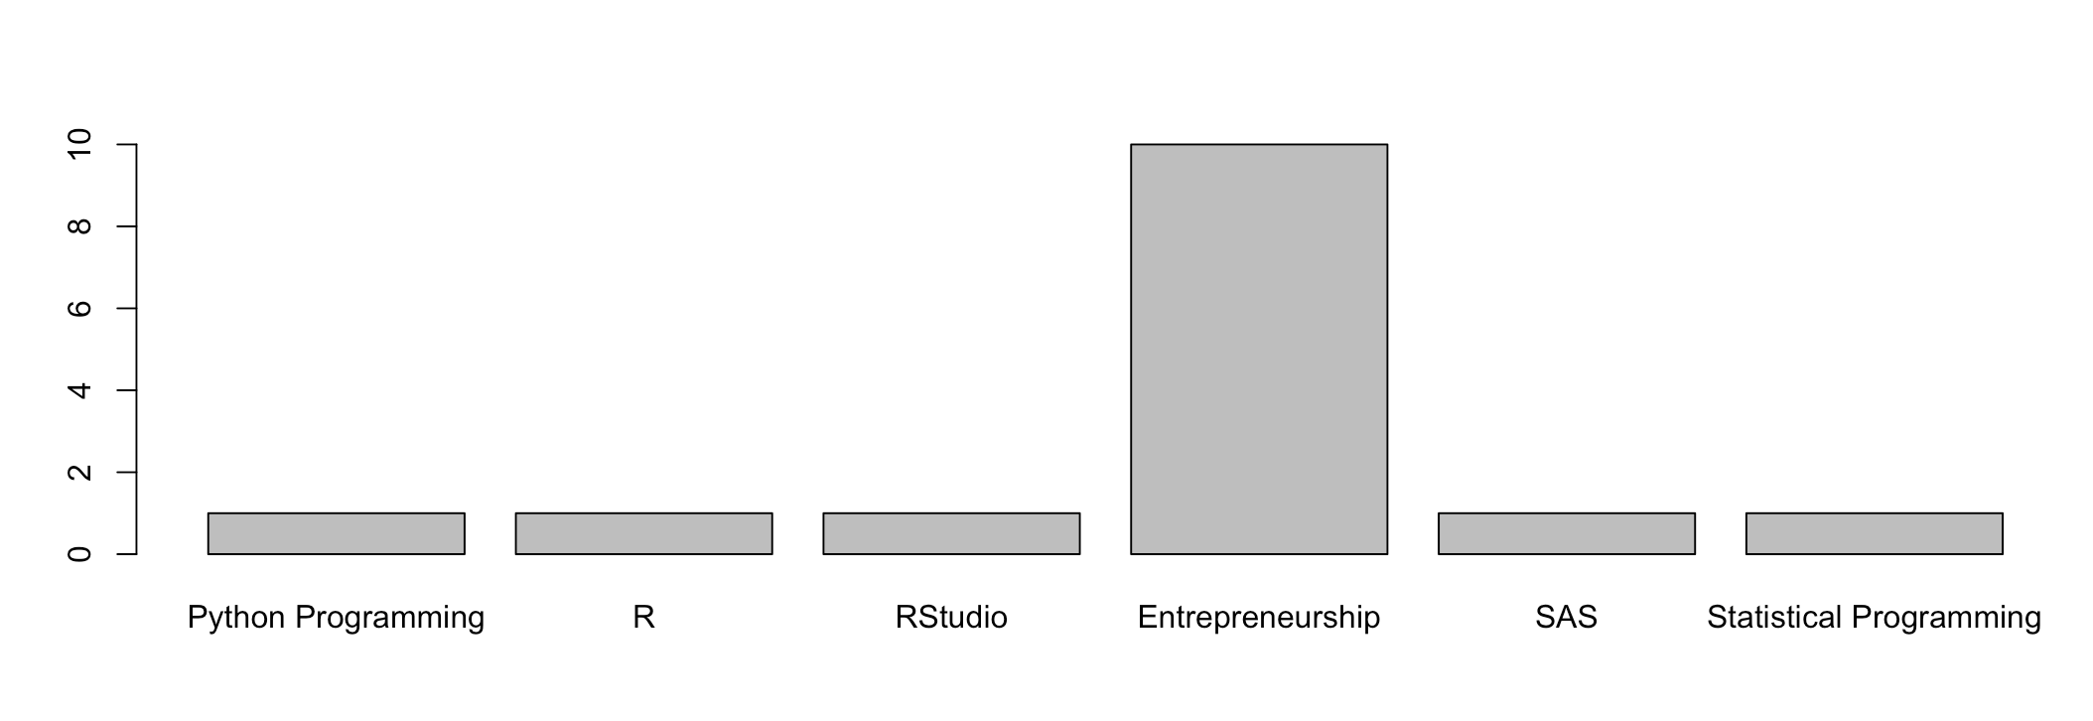
1. Data Science Profile: Make a bar plot for your data science profile.
skills<- c("Python Programming", "R", "RStudio", "Entrepreneurship", "SAS", "Statistical Programming")
Experience <- c(1, 1, 1, 10, 1, 1)
barplot(Experience, names.arg = skills)

Slide 5
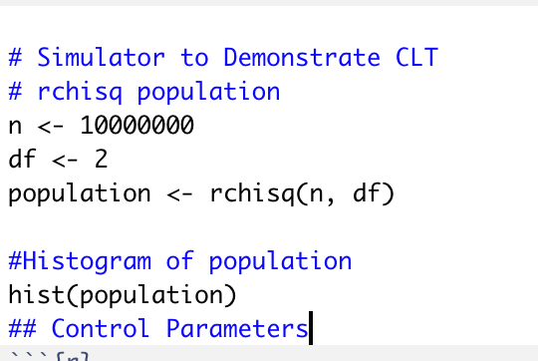
1. Adapt the code to generate a population of 10,000,000 from a chi-square distribution with 2 degrees of freedom. This is a heavily right skewed distribution. (Hint: rchisq()). You will have to read up on this function and probably do some trial and error. Being able to earn new functions and methods is a key skill.

Slide 6
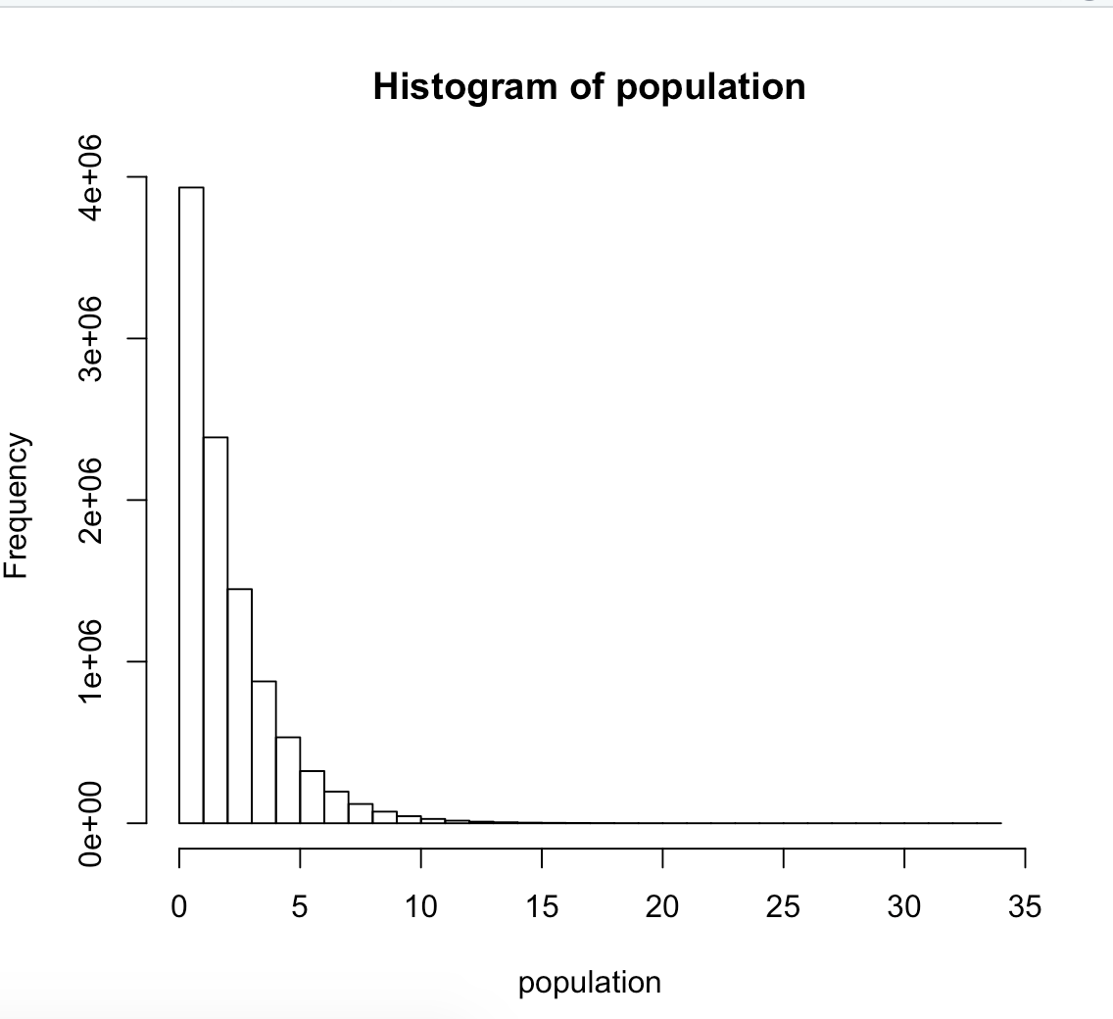
2. Provide a histogram of this population… display the right skewness.

Slide 7
3. Record the mean and standard deviation of this population.
# Mean of population
mean(population)
#Standard Deviation of population
sd(population)
> mean(population)
[1] 1.999785
> sd(population)
[1] 1.999959

Slide 8
4. According to the central limit theorem, what should be the approximate distribution of sample means of size 50 from this right skewed population? What should be the mean and standard error of the mean (standard deviation of the distribution of sample means)?
# According to the central limit theorem, what should be the approximate distribution of sample means of size 50 from this right skewed population? What should be the mean and standard error of the mean (standard deviation of the distribution of sample means)?
#Mean of sample is equal to the Mean of the population, so Mean will remain the same
mean(population) = 1.999785
#Standard Deviation of the Sampling Distribution
n <- 50
mean = 1.999785
sd = 1.999959
sqrt(n)
mean/sqrt(n)
#Standard Error of the mean
(n - mean) / (sd / sqrt(50))
> n <- 50
> mean = 1.999785
> sd = 1.999959
> sqrt(n)
[1] 7.071068
> mean/sqrt(n)
[1] 0.2828123
> (n - mean) / (sd / sqrt(50))
[1] 169.7099

Slide 9
5. Now let’s check this: Adapt the CLT code to draw 10,000 means each of size 50 from this population and provide the sampling distribution of this sample mean. Provide a histogram of these 10,000 sample means.
## Control Parameters
```{r}
n1 = 50 # sample size per sample
simulations = 10000 #number of samples and thus number of xbars we will generate.
mu = 0; # mean parameter for use with normal distributions
sigma = 1; # standard deviation parameter for use with normal distributions
xbar_holder1 = numeric(simulations) # This will hold all the sample means for the distribution.
## Simulate and Store
Generate 10000 samples each of size 50 and find the mean of each sample. Then store each mean in the xbar_holder vector.
for (i in 1:simulations)
{
sample1 = rnorm(n1,mean = mu, sd = sigma)
xbar1 = mean(sample1)
xbar_holder1[i] = xbar1
}
## display the distribution of sample means (plot a histogram of the sample means)
hist(xbar_holder1, col = "blue", main = paste("Distribution of the sample mean: n = ", n1), xlab = "Dist 1 Sample Means", xlim = c(-4,4))

Slide 10
6. What is the mean and standard deviation of these 10,000 sample means?
## summary statistics of the distribution of the simulated sample means.
summary(xbar_holder1) #number summary and the mean
sd(xbar_holder1) # standard deviation of distribution 1
> summary(xbar_holder1) #number summary and the mean
Min. 1st Qu. Median Mean 3rd Qu. Max.
-0.5683650 -0.0951445 -0.0006545 0.0002089 0.0972071 0.4993460
> sd(xbar_holder1) # standard deviation of distribution 1
[1] 0.1415338

Slide 11
3. T-Test
Research in R how to conduct a T-test (t.test) and conduct a six step hypothesis test to answer the question on the next slide. If you would like to brush up on hypothesis tests, please see the Bridge Course for Statistics.
The following are ages of 7 randomly chosen patrons seen leaving the Beach Comber in South Mission Beach at 7pm! We assume that the data come from a normal distribution and would like to test the claim that the mean age of the distribution of Comber patrons is different than 21. Conduct a 6 step hypothesis test to test this claim.
25, 19, 37, 29, 40, 28, 31
> x = c(25, 19, 37, 29, 40, 28, 31)
> t.test(x, mu = 21, alternative = "two.sided")
One Sample t-test
data: x
t = 3.3093, df = 6, p-value = 0.01622
alternative hypothesis: true mean is not equal to 21
95 percent confidence interval:
23.30816 36.40613
sample estimates:
mean of x
29.85714

Slide 12
4. Takeaways and/or Questions: What were your key – takeaways from from this unit and what were any question or comments you would like to make? Your professor will use these to customize live session.
I learned about Reproducible Research, tools to be used for the same – R, Rstudio, rmarkdown, knitr etc
Learned about GitHub, Git, Importing data as well as manipulating data
Rstudio is fun & extremely engaging. It feels like playing a video game!
The interview with Director Frank Rossi was extremely helpful. Frank’s advice about never letting go of traditional statistics as well as remembering that sometimes simple solutions are the best solutions were quite helpful

